Slide 1
Studying Mask R-CNN in a practical way
Qifan Wu,Yuelun Wang
Tufts University
ECE&HRI Department

Slide 2
Overview
Introduction of Problem
Architecture
Modification
Experiment and Result

Slide 3
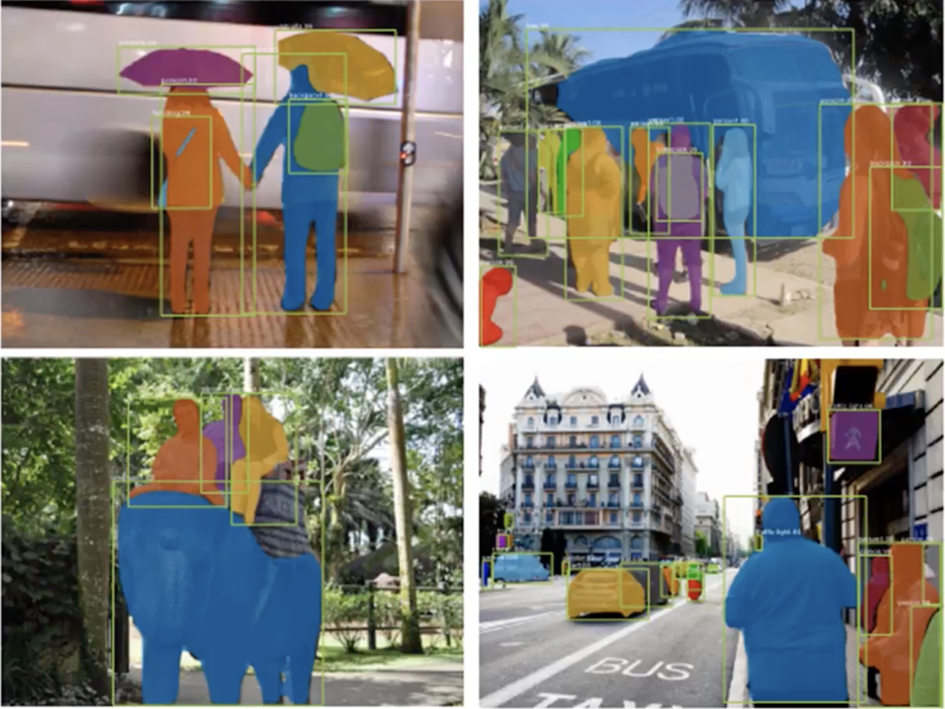
Introduction of problem
Mask R-CNN is a conceptually simple, flexible, and general framework for object instance segmentation. This approach efficiently detects objects in an image while simultaneously generating a high-quality segmentation mask for each instance.

Slide 4
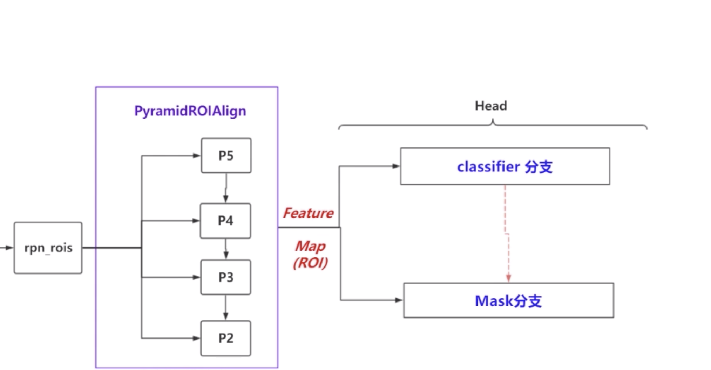
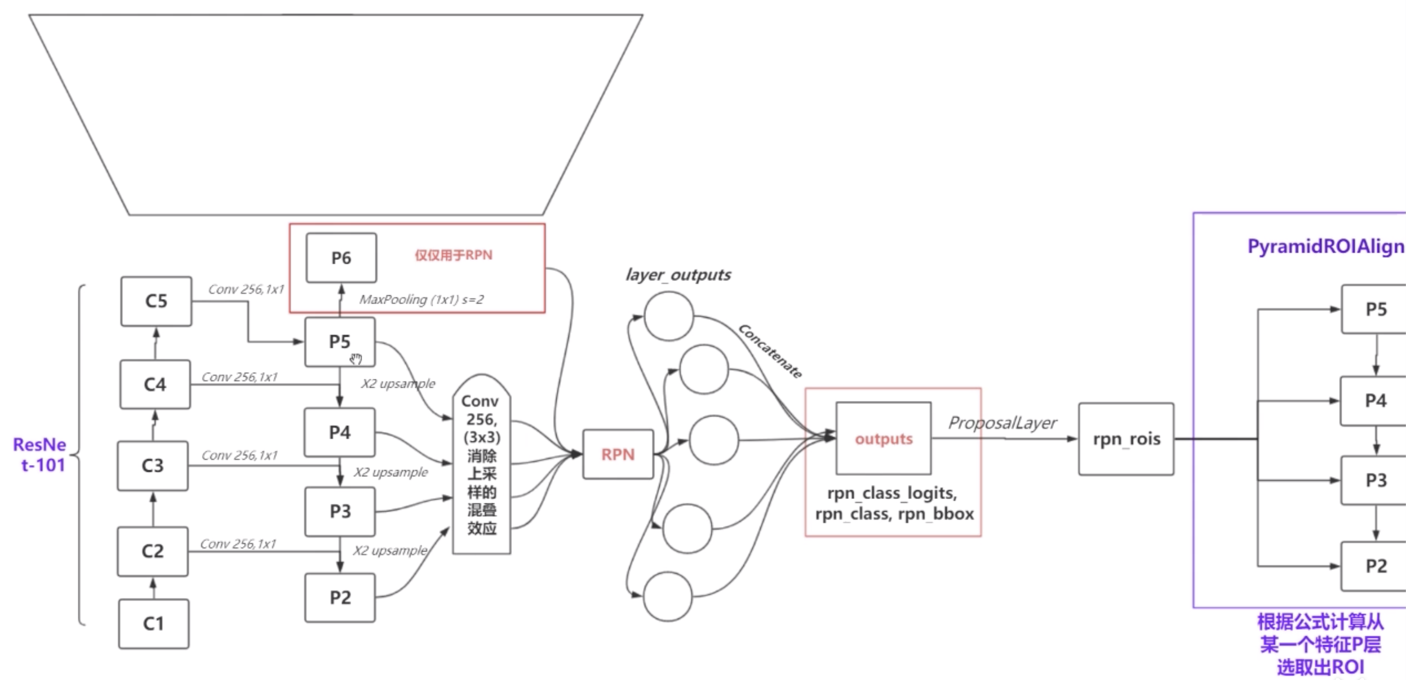
Architecture of Mask RCNN

Slide 5
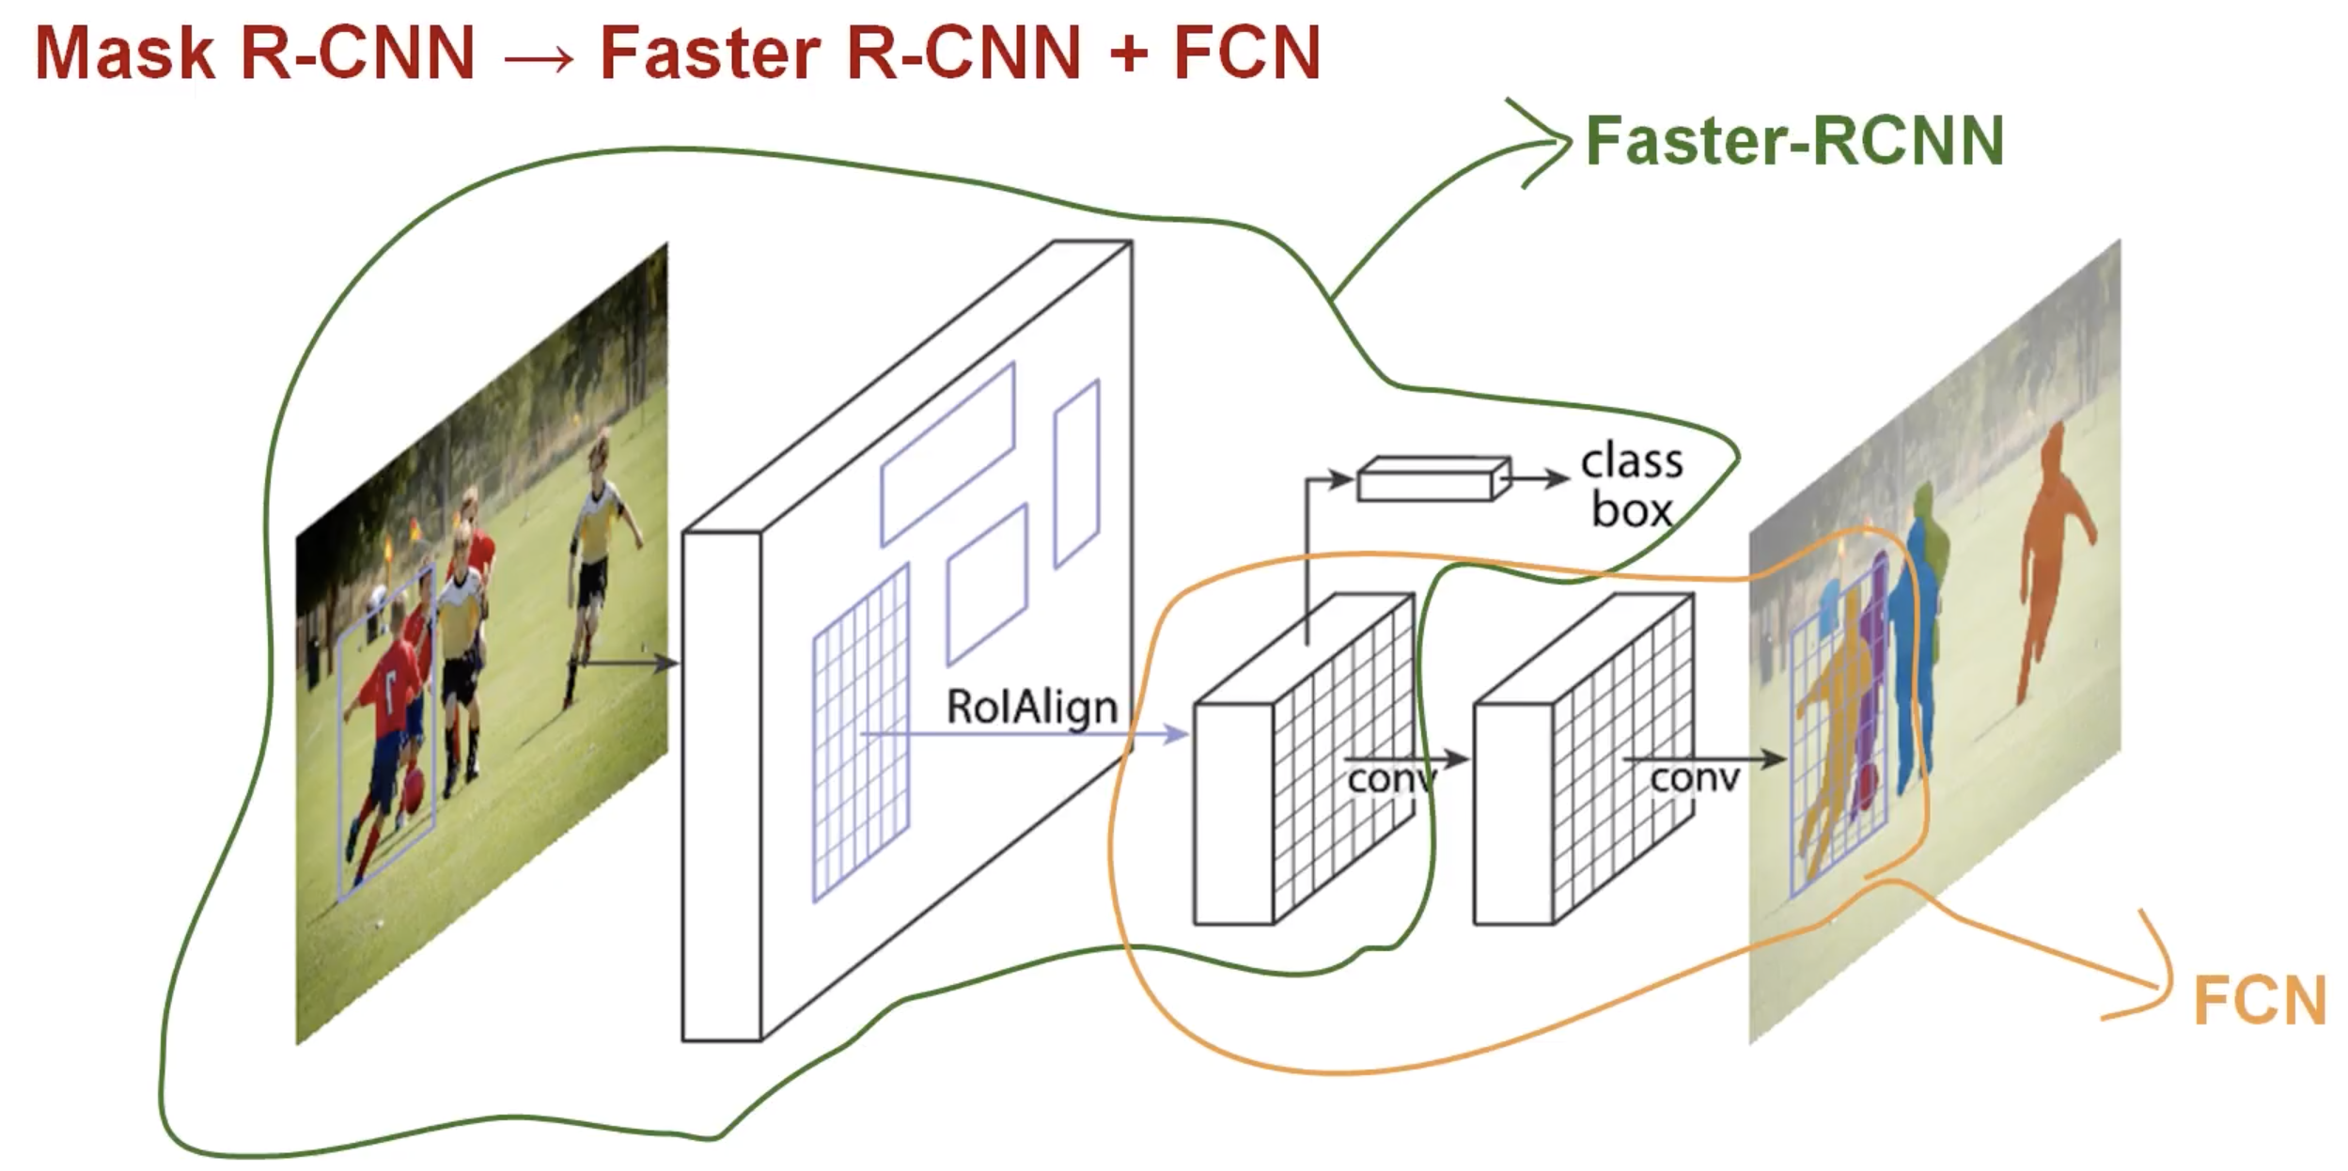
Architecture of Mask RCNN

Slide 6
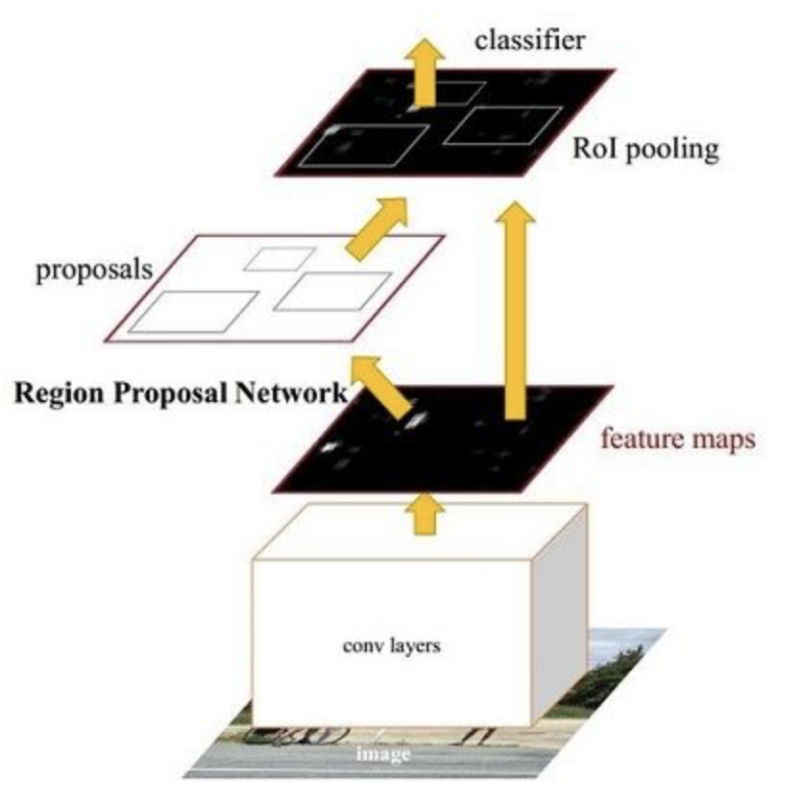
Region Propose Network
Data we feed into RPN is generated by FPN
2 losses, classification loss and regression
Bounding boxes have different size

Slide 7
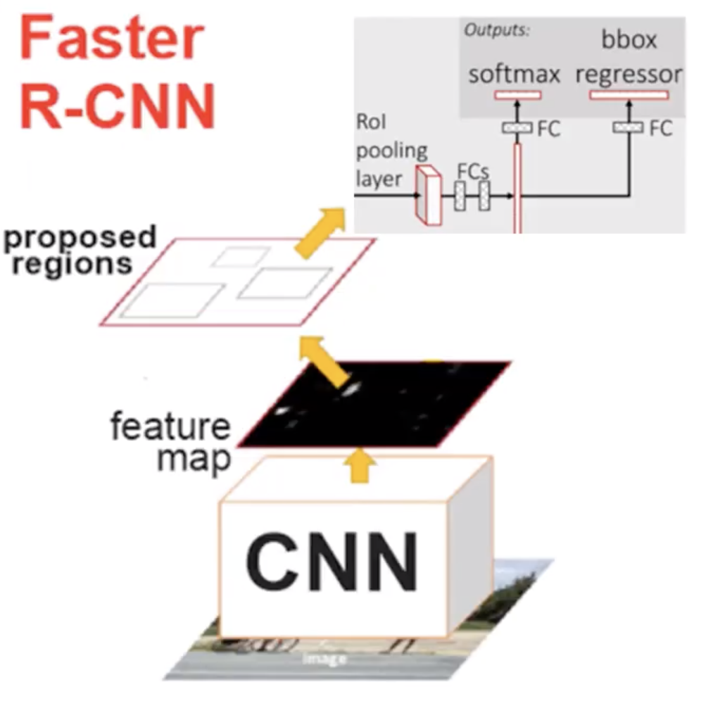
Region Propose Network
2 losses, classification loss and regression loss
How does Faster RCNN propose a region containing object?
Bounding boxes have different size

Slide 8
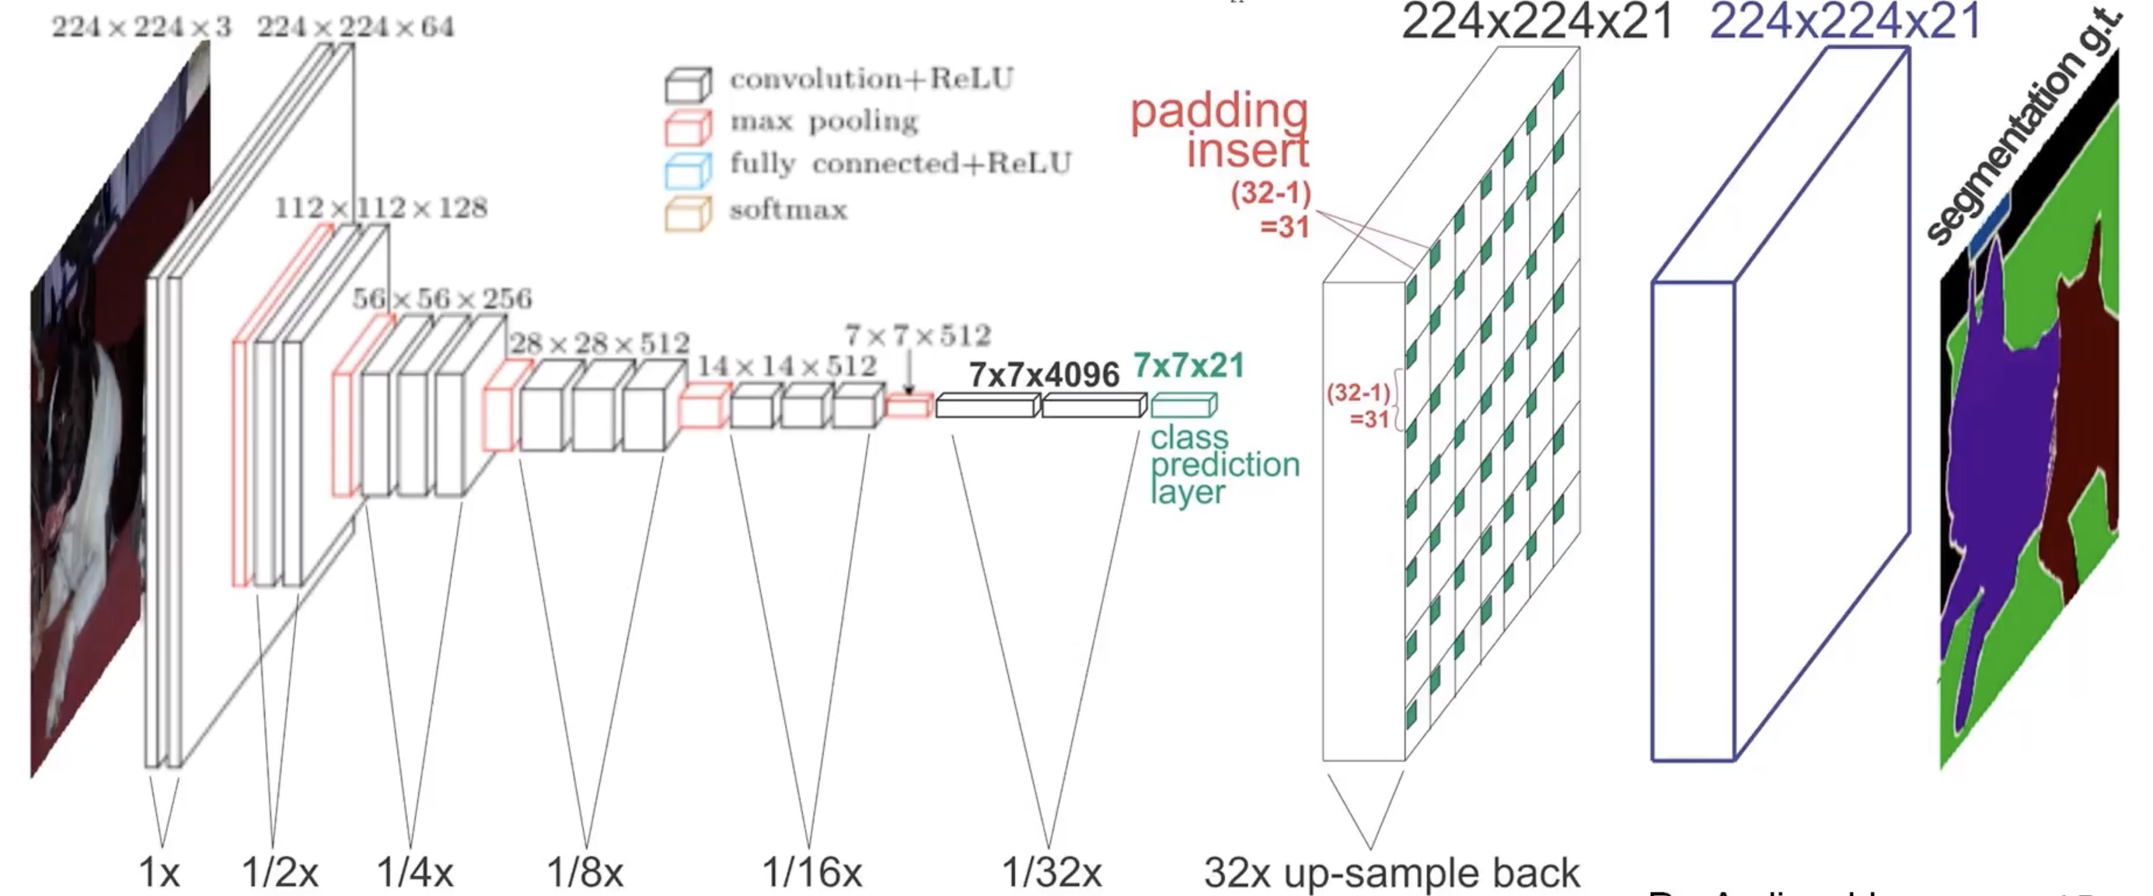
Architecture of Fully Convolutional Network

Slide 9
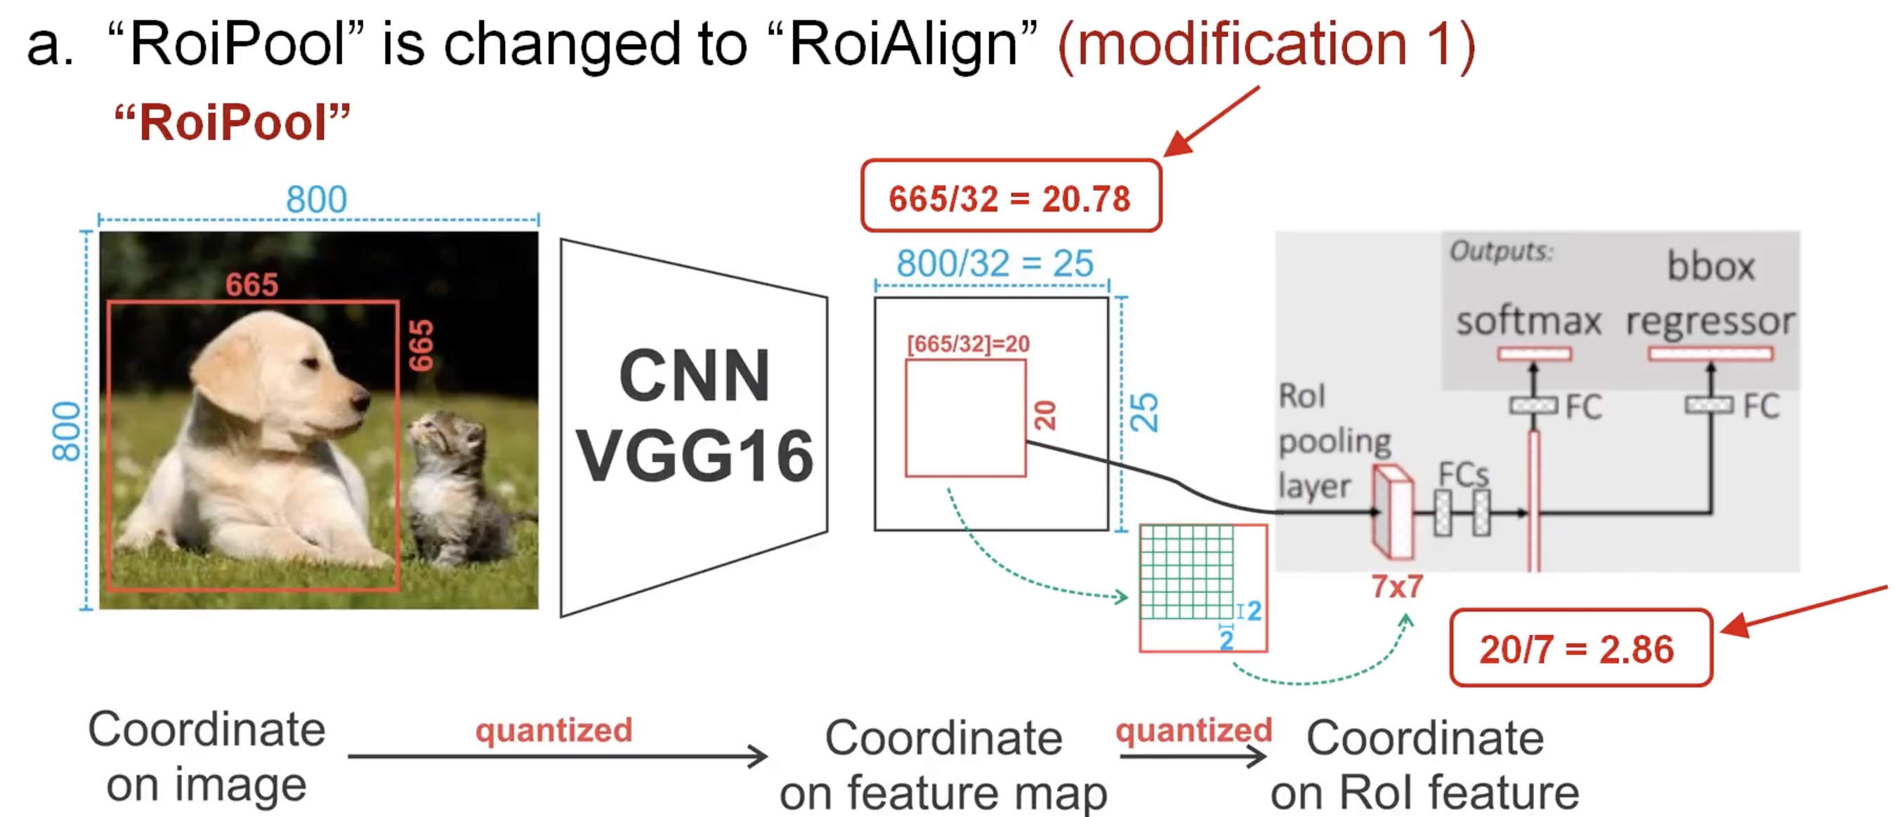
Modificaton

Slide 10
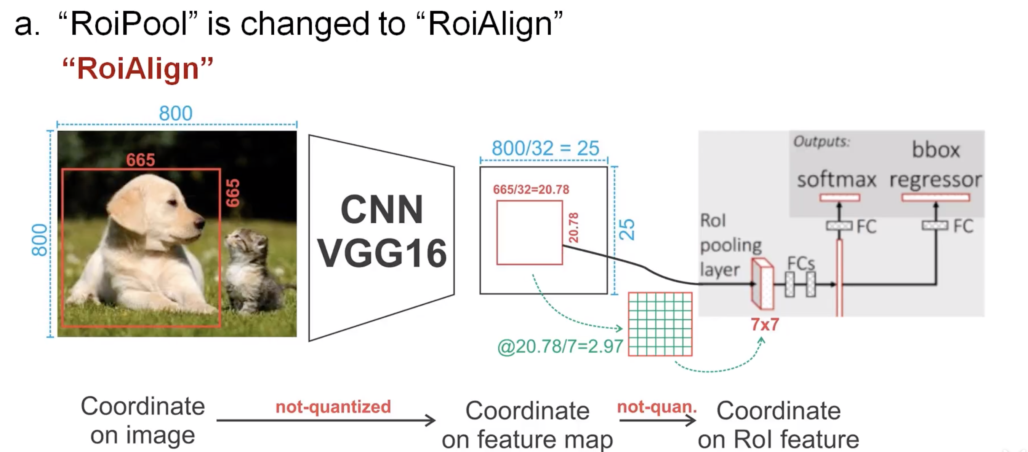
Modificaton

Slide 11
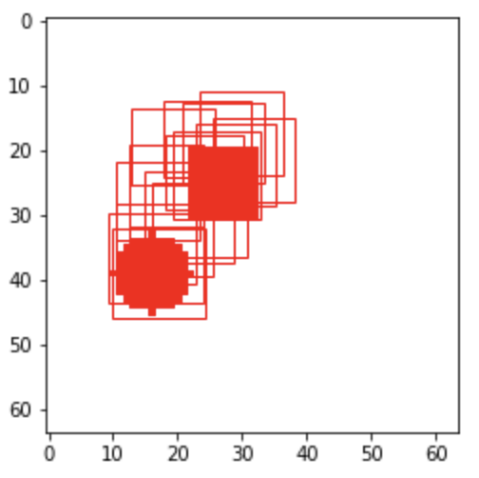
Experiment and Result
Region Proposal Network proposes not just one region
Too much overlapping means same object
It actually works!

Slide 12
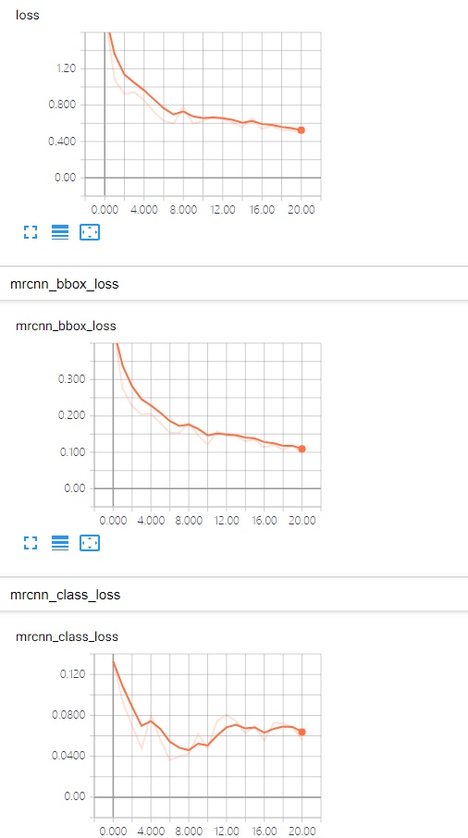
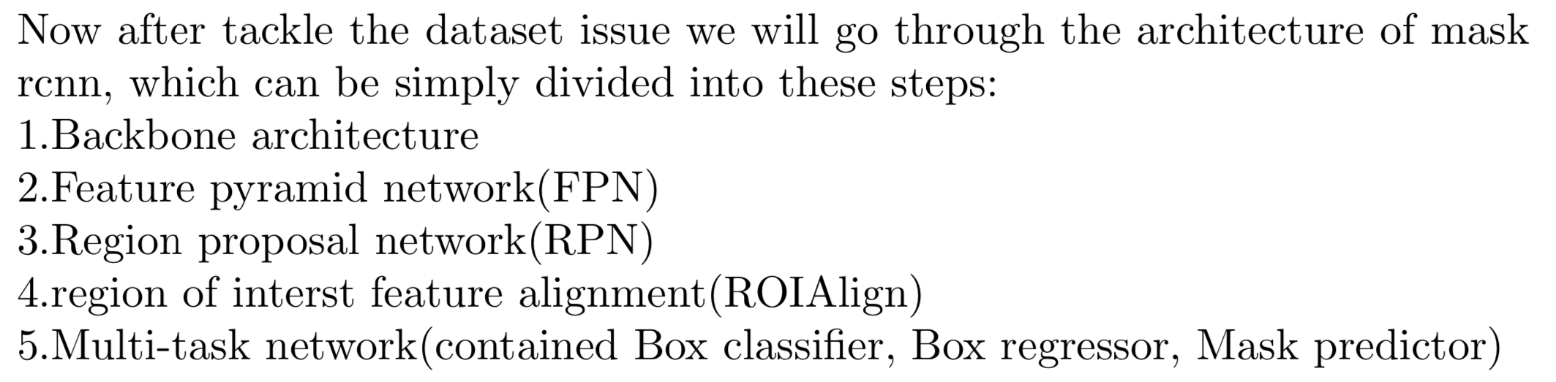

Slide 13
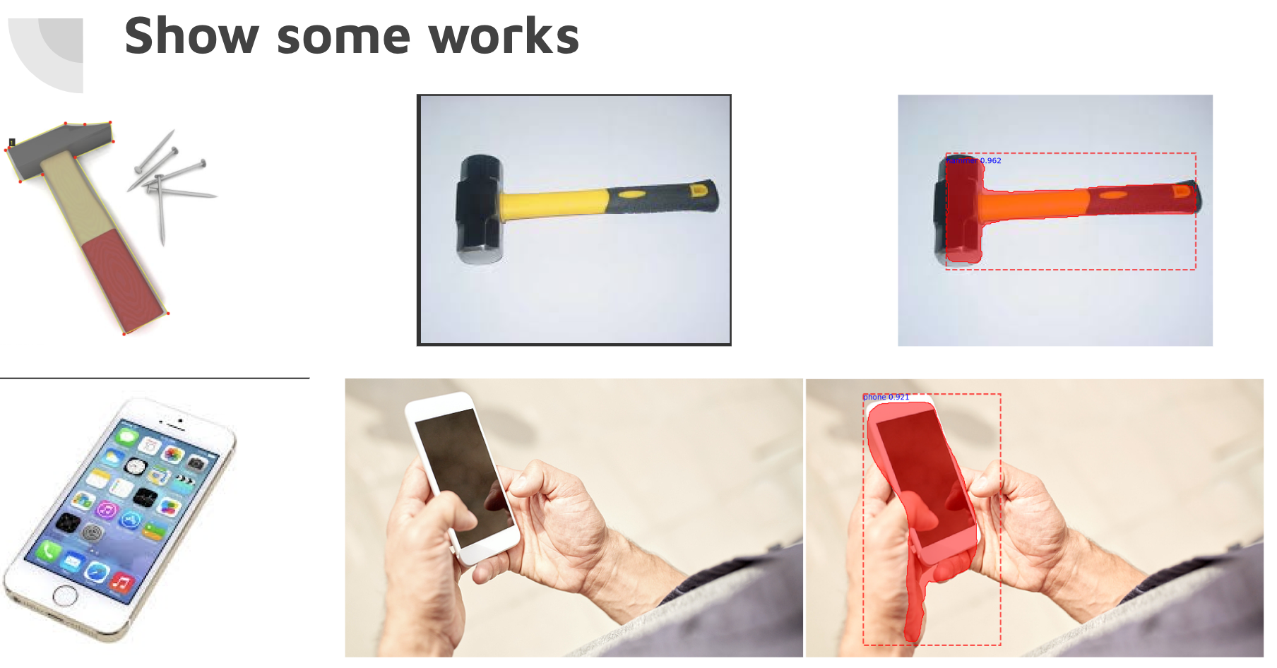

Slide 14
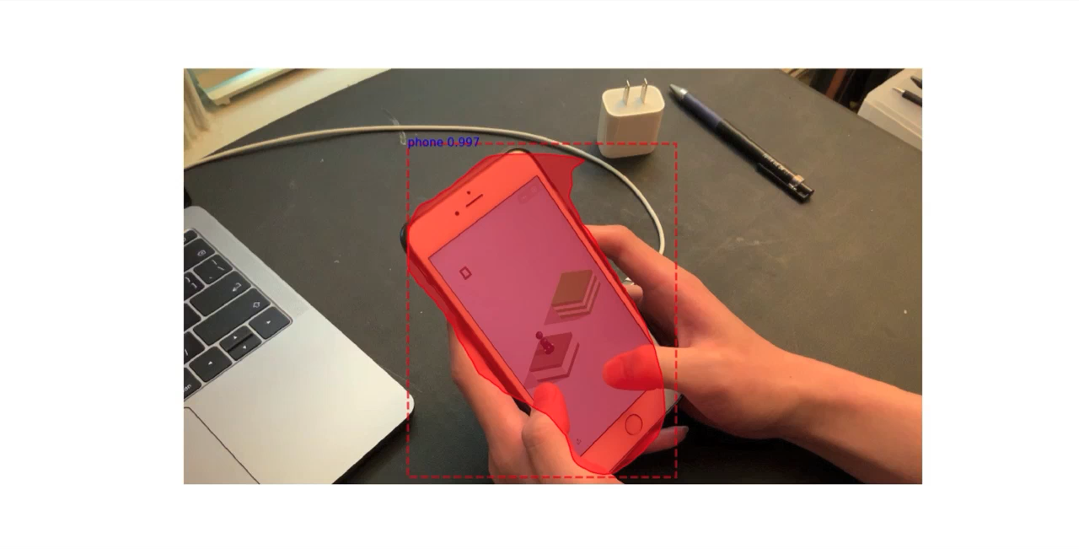

Slide 15
Question?

